Slide 1
Support at Leeds
A session with information and activities to help you to:
find out about your support network
take care of yourself and your student community
1
Notes:
1

Slide 2
Support at Leeds
Introduction to our support for you
Notes:
1

Slide 3
Support at Leeds
Our Vision “To enable and empower you to engage fully with all aspects of student life, removing barriers as necessary, so you can achieve your potential and succeed in your studies’’
It’s about…..
Maintaining
your wellbeing
‘ where each individual realises his or her own potential, can cope with the normal stresses of life, can work productively and fruitfully and is able to make a contribution to his or her community’ World Health Organisation
Meeting challenges
‘a task or situation that tests a person’s abilities’ Oxford dictionaries https://en.oxforddictionaries.com
Notes:
1

Slide 4
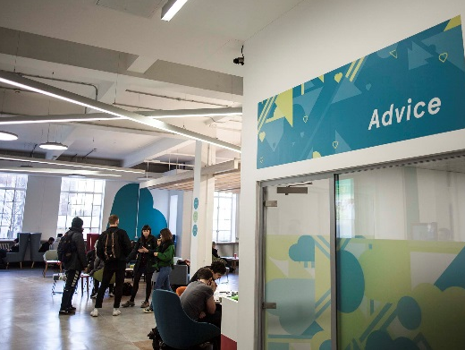
Support at Leeds
A wide range of support
Support to manage student life and develop skills to meet challenges
Activities to build friendships and maintain your wellbeing and health
Free specialist confidential support services and independent advice
Notes:
1

Slide 5
Support at Leeds
Online information you can use independently
https://students.leeds.ac.uk
Faculty/School website/Minerva area
luu.org.uk
Contact points for questions and to find out how to get the right support
Student Office in School
Help and Support in Leeds University Union
Personal Tutor (academic support)
Skills@Library (study skills)
Advice in Leeds University Union
Student Counselling and Wellbeing
Disability Services
Student Services (including finance)
International Student Office (immigration)
Lifelong Learning Centre (mature students)
Accommodation Wardens and Residence Life Assistants
Chaplaincy and Muslim Student Adviser
University Security
Specialist support and advice to enable and empower you to meet challenges
Notes:
1

Slide 6
Support at Leeds
Student Counselling and Wellbeing
Free, confidential, specialist support from an experienced team of counsellors, mental health advisers and wellbeing practitioners
The team works with students to identify solutions to difficulties and signpost or refer to specialist services in Leeds
Support includes: wellbeing drop-ins; single session consultations; groups and workshops; online resources; short series of counselling or wellbeing appointments; weekly meditation; downloadable relaxation MP3s on website
To book an appointment, complete the Student Counselling and Wellbeing Self-Referral Form on https://students.leeds.ac.uk/counsellingandwellbeing
Notes:
1

Slide 7
Support at Leeds
Disability Services
Confidential, specialist advice, guidance and support for disabled students, including those with physical disabilities, mental health conditions, autism spectrum condition, specific learning needs (e.g. dyslexia) and long term medical conditions.
The team identifies and recommends adjustments schools can make for individuals.
Start by filling in Disability Services’ online sign-up form at https://students.leeds.ac.uk/settingupyoursupport
Perhaps you had support or adjustments at school or during previous study? Contact the team at disability@leeds.ac.uk, or look at the website below to see if you might benefit from the team’s services.
Contact our friendly Disability Services team to find out more. No appointment needed, confidential drop-ins between 9:30am and 4pm Monday to Friday. http://students.leeds.ac.uk/disabledstudents
Notes:
1

Slide 8
Support at Leeds
Funding and Money Support
Student Funding Team in Student Services Centre
Help and guidance on student funding
Can communicate directly with Student Finance England (and other funding bodies) to help resolve funding issues
Administer applications to Leeds Hardship Fund and International Leeds Hardship Fund https://students.leeds.ac.uk/fundsandscholarships
You can email to the Student Finance team at funding@leeds.ac.uk
Advice in Leeds University Union
Money help, budgeting advice, financial support luu.org.uk/student-help-support
Notes:
1

Slide 9
Support at Leeds
Activities for friendship, wellbeing
and health
Five Ways to Wellbeing*
Connect
Be active
Take notice (mindfulness)
Keep learning
Give
*Five ways to wellbeing report New Economics Foundation
Notes:
1

Slide 10
Support at Leeds
Our Support Partnership
Students:
University & Leeds University Union (LUU):
seek information/ advice/support in good time
contribute positively to your community
let University/ Leeds University Union (LUU) know about problems or what may need to change
empower you to manage student life and meet challenges
work with students to understand what’s happening and what’s needed
develop and provide support services and activities
STUDENTS
LUU
OUR SUPPORT PARTNERSHIP
UNIVERSITY
Notes:
1

Slide 11
Support at Leeds
Students supporting students, for example:
School-based peer support
School reps (representatives)
Academic societies
Other student-run societies
luu.org.uk/clubs-and-societies/welfare/
Notes:
1

Slide 12
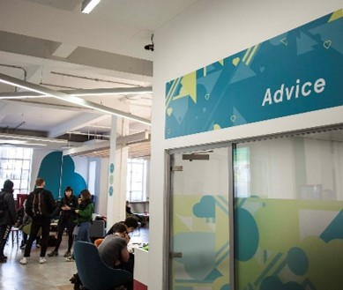
Support at Leeds
Another example …
A partnership of students, University and Leeds University Union staff developed the “Draw the Line” project to help the University community to stand up to harassment.
The project raises
awareness of the campus online reporting form and the support available from
LUU Advice
LUU ADVICE
PROJECT AMBASSADORS
Notes:
1

Slide 13
Support at Leeds
Emergency and outside office hours contact points
University Security Office
Open 24 hours, every day of the year
175 Woodhouse Lane; email security@leeds.ac.uk Tel: 0113 343 5494/5 (non-emergencies); 0113 343 2222 (emergencies)
Ambulance/Police/Fire Emergency phone 999
Police non-emergency phone 101
Nearest Hospital Accident & Emergency is at Leeds General Infirmary
If ambulance is called for on campus, ring University Security to inform them
Wellbeing Crisis information on https://students.leeds.ac.uk/supportandwellbeing
Wardens and Residence Life Assistants in University accommodation
Notes:
1

Slide 14
Support at Leeds
Together all – Wellbeing support at any time
Free to all students at the University of Leeds - togetherall.com
Notes:
1

Slide 15
Support at Leeds
Supportive conversation with another student
Leeds Nightline
1 to 1 with a trained student outside office hours
Talk to school Student Support Officer
Universities Chaplaincy
1 to 1 with a Chaplain
Personal tutor for academic support
Support when you need it
Sport and Physical Activity
Activity to support your wellbeing
Skills@Library
study skills workshops, appointments and resources
Student Counselling and Wellbeing
workshops, groups and online resources
Disability Services
support for students affected by a long term condition e.g. dyslexia
Leeds University Union
wellbeing and social activities and workshops
Together All
online resources and support
Notes:
<number>

Slide 16
Support at Leeds
Take away messages …
Your time at University will test you in different ways, but you’ll be empowered to find solutions. You’ll develop skills to meet challenges while you’re studying and in your future lives.
Make time for wellbeing (5 ways) – for the best experience and academic results
Remember the range of support offered by the University, Leeds University Union and other students, including 24/7
Ask for help as soon as you need it. It’s a normal part of University life, a strength not a weakness.
A warm welcome to our supportive University community!
Notes:
<number>

